Slide 1
A* search
Example

Slide 2
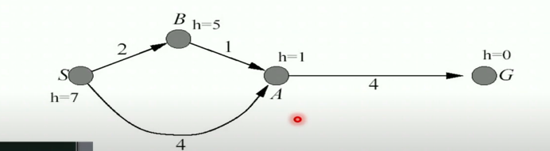
Example

Slide 3
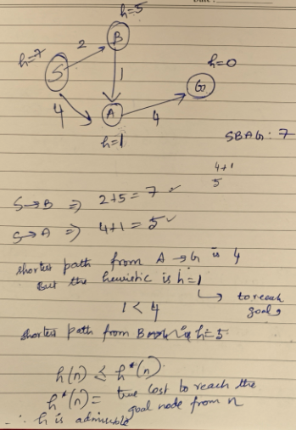
Example

Slide 4
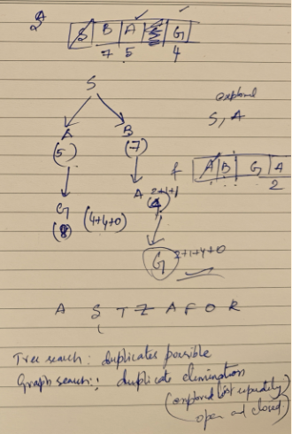
Example

Slide 5
Admissible Heuristic
First condition required for optimality is that h(n) be an admissible heuristic
never overestimates the cost to reach the goal
Remember h(n) = 0 when n is the goal state
i.e. h(n) ≥ 0, such that at any goal state node G, h(G) = 0, otherwise h(n) > 0
and f(n)=g(n) + h(n), [g(n) = actual cost to reach n along the current path]
Then at G, f(n) = g(n) + 0 = g(n) [actual distance]
The above have an immediate consequence that f(n) never overestimates the true cost of a solution along the current path through n
h(n) ≤ h*(n) where h*(n) is the true cost of n to goal
Example: h_{SLD}(n) never overestimates the actual road distance
So A* using h_{SLD} is optimal

Slide 6
Admissible Heuristic
The tree-search version of A* is optimal if h(n) is admissible
The graph-search version of A* is optimal if h(n) is consistent
Consistency (Monotonicity)
A heuristic h(n) is consistent
if, for every node n and every successor n’ of n generated by any action a,
the estimated cost of reaching the goal from n is no greater than (a) the step cost of getting to n’ + (b) the estimated cost of reaching goal from n’
Consistency/Monotonicity is a form of the general triangle inequality,
Each side of a triangle cannot be longer than sum of other two sides
Here, the triangle is formed by n, n’ and the goal G_{n} closest to n
For an admissible heuristic, the inequality makes perfect sense:
if there were a route from n to Gn via n’ that was cheaper than h(n), that would violate the property that h(n) is a lower bound on the cost to reach G_{n}.

Slide 7
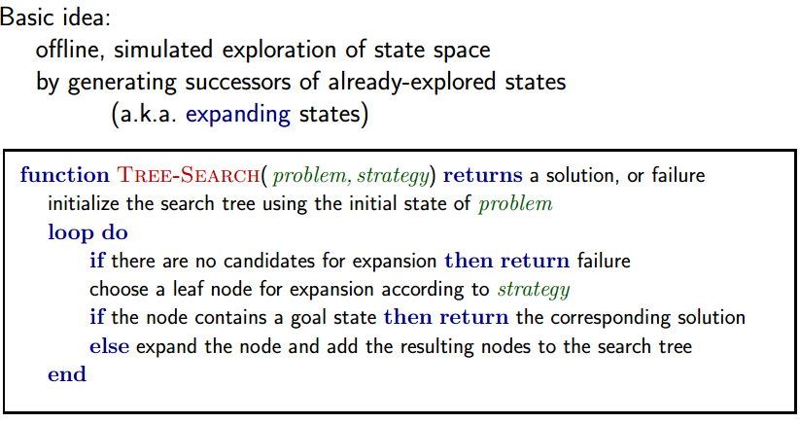
Tree Search
Solution is an action sequence
Search algorithms work by considering various possible action sequences
Possible action sequences starting at the initial state form a search tree
with the initial state at the root
Expanding the current state (Frontier – leaf nodes available for expansion)
Generating a new set of states
Exploring the new states

Slide 8
Tree Search
Search algorithms all share this basic structure
Vary primarily on how they choose which state to expand next - called search strategy

Slide 9
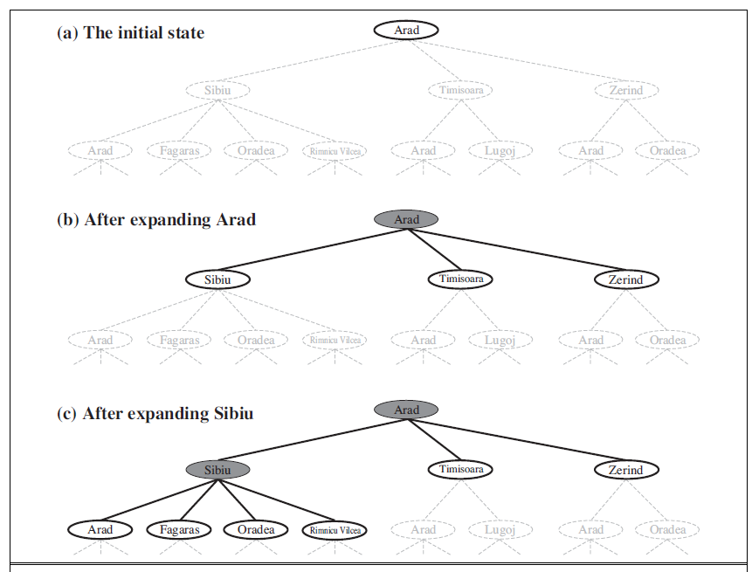
Tree search example
Partial search trees for finding a route from Arad to Bucharest
Expanded Nodes are shaded
Generated but not yet expanded nodes are outlined in bold
Not yet generated nodes in faint dashed lines

Slide 10
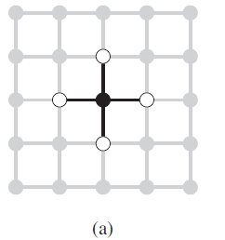
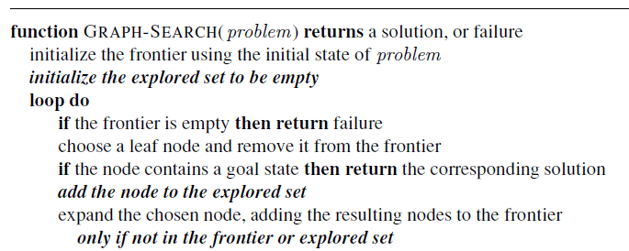
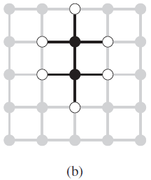
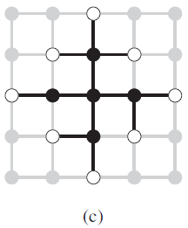
Graph Search
Bold italic in GRAPH-SEARCH are additions needed to handle repeated states
Redundant paths are unavoidable
algorithms that forget their history are doomed to repeat it
avoid exploring redundant paths is to remember where one has been

Slide 11
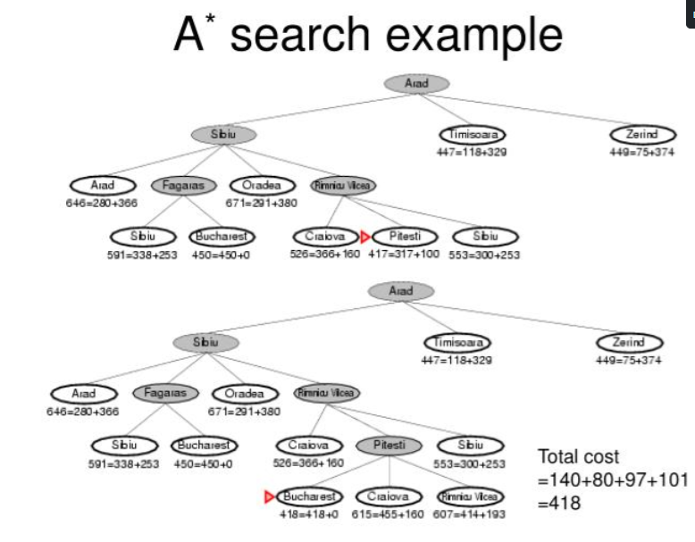

Slide 12
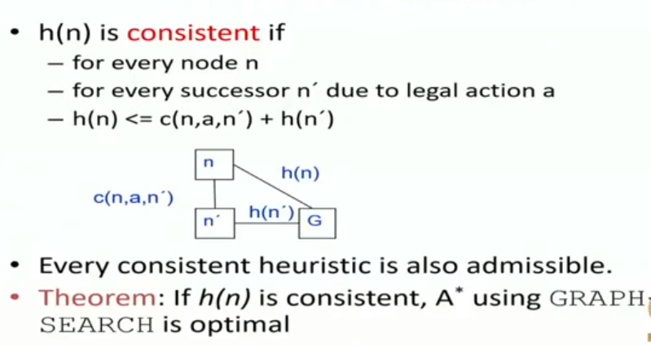
Consistent heuristics

Slide 13
A* heuristics
Tree A* version is optimal-when heuristic is admissible
Graph A* version is optimal-when heuristic is consistent
Consistency subsumes admissibility so if consistent then it is always admissible

Slide 14
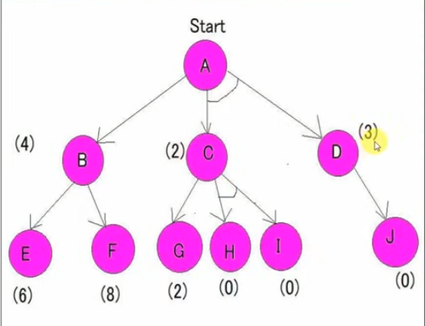
AO* EXAMPLE

Slide 15
